Slide 1
Advanced Braking Technology Limited
Annual General Meeting 2016

Slide 2
Agenda
Board Introduction
Chairman’s Address
Formal Business
CEO’s Report
Questions and Answers
Diagram 1: An exploded schematic of a SIBS® brake

Slide 3
Chairman’s Address
Board and Other Introductions

Slide 4
Chairman’s Address
Mr Bruce Grey
Chairman

Slide 5
Formal Business
Formal Business

Slide 6
Proxies – Summary of the 7 Resolutions
# | Resolution | For | Against | Open | Abstain | Total
1 | Adoption of Remuneration Report | 349,597,678 | 109,856,772 | 5,854,007 | 692,700 | 466,001,157
2 | Re-election of Mr. David Slack | 376,883,829 | 104,462,717 | 63,866,561 | 665,528 | 545,878,635
3 | Ratification of prior issue of Placement Shares under Listing Rule 7.1 | 159,217,455 | 5,179,059 | 62,366,561 | 660,863 | 227,423,938
4 | Ratification of prior issue of Placement Shares under Listing Rule 7.1A | 159,117,455 | 5,179,059 | 62,466,561 | 660,863 | 227,423,938
5 | Approval of the Performance Rights Plan | 337,037,387 | 121,279,343 | 7,292,579 | 391,848 | 466,001,157
6 | Participation in the Performance Rights Plan by Mr Graeme Sumner | 351,828,168 | 122,717,915 | 62,417,989 | 627,563 | 537,591,635
7 | Approval of 10% Placement Facility | 365,642,419 | 116,127,807 | 63,866,561 | 241,848 | 545,878,635

Slide 7
Formal Business
Financial Statements and Reports

Slide 8
Proxies – Resolution 1
 | Resolution 1:
 | Adoption of Remuneration Report
 | Vote | Votes | %
 | For | 349,597,678 | 75.13
 | Against | 109,856,772 | 23.61
 | Open Usable Board | 5,854,007 | 1.26
 | Abstain | 692,700 | n/a

Slide 9
Proxies – Resolution 2
 | Resolution 2:
 | Re-election of Mr David Slack
 | Vote | Votes | %
 | For | 376,883,829 | 69.13
 | Against | 104,462,717 | 19.16
 | Open Usable Board | 63,866,561 | 11.71
 | Abstain | 665,528 | n/a

Slide 10
Proxies – Resolution 3
 | Resolution 3:
 | Ratification of prior issue of Placement Shares under Listing Rule 7.1
 | Vote | Votes | %
 | For | 159,217,455 | 70.22
 | Against | 5,179,059 | 2.28
 | Open Usable Board | 62,366,561 | 27.5
 | Abstain | 660,863 | n/a

Slide 11
Proxies – Resolution 4
 | Resolution 4:
 | Ratification of prior issue of Placement Shares under Listing Rule 7.1A
 | Vote | Votes | %
 | For | 159,117,455 | 70.17
 | Against | 5,179,059 | 2.28
 | Open Usable Board | 62,466,561 | 27.55
 | Abstain | 660,863 | n/a

Slide 12
Proxies – Resolution 5
 | Resolution 5:
 | Approval of the Performance Rights Plan
 | Vote | Votes | %
 | For | 337,037,387 | 72.38
 | Against | 121,279,343 | 26.05
 | Open Usable Board | 7,292,579 | 1.57
 | Abstain | 391,848 | n/a

Slide 13
Proxies – Resolution 6
 | Resolution 6:
 | Participation in the Performance Rights Plan by Mr Graeme Sumner
 | Vote | Votes | %
 | For | 351,828,168 | 65.53
 | Against | 122,717,915 | 22.85
 | Open Usable Board | 62,417,989 | 11.62
 | Abstain | 627,563 | n/a

Slide 14
Proxies – Resolution 7
 | Resolution 7:
 | Approval of 10% Placement Facility
 | Vote | Votes | %
 | For | 365,642,419 | 67.02
 | Against | 116,127,807 | 21.28
 | Open Usable Board | 63,866,561 | 11.70
 | Abstain | 241,848 | n/a

Slide 15
Advanced Braking Technology Limited
25 November 2016
Annual General Meeting
Graeme Sumner, Managing Director

Slide 16
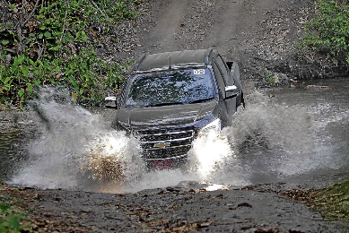
Financial Performance & Capital Management
FY 2016 was our most challenging year with many industry equipment providers describing it as the worst in 20 years
FY 2017 has started much better with Q1 operating revenue of 1.46m, up 103% in the first quarter but the market has reinforced the need for lower cost innovative technologies
Market support for the Terra Dura Polymer brake has been excellent with the 2.7m capital raising in August heavily oversubscribed.
Total expenses down 22% on the first 4 months last year, but sales and marketing expenditure to rise from November to support the Terra Dura roll out.

Slide 17
Financial Performance & Capital Management

Slide 18
Financial Performance & Capital Management

Slide 19
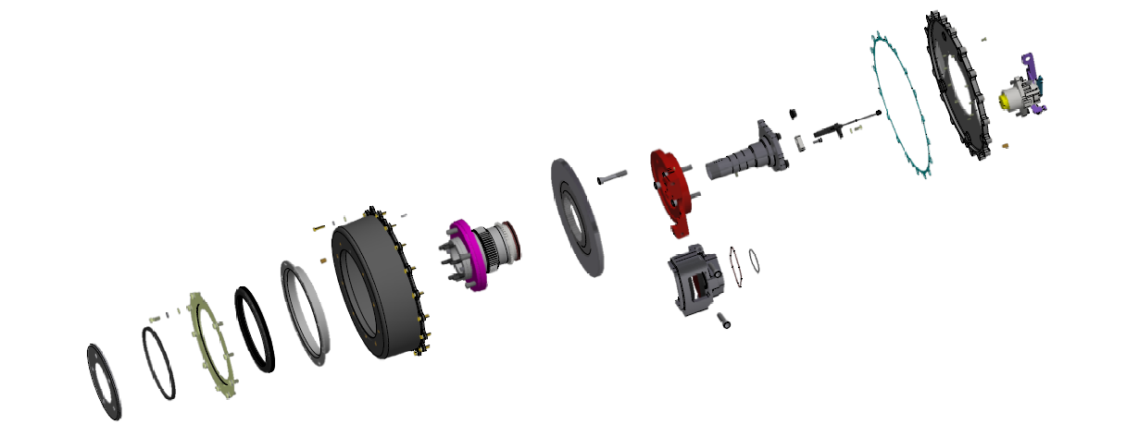
Terra Dura Launch and Roll Out Update
New Terra Dura Supplier Relationships established. While this resulted in a delay to our program the result has been a 35% reduction against targeted cost price.
Product Launch at 4x4 show in Victoria and Minexpo Las Vegas. Feedback from customers and distributors was excellent.
Website development underway for full site and specialist site ( www.terradurabrakes.com )
Delivery of first 120 Terra Dura Landcruiser kits arrive in mid January
Brakes operating at
Savage River Tasmania
Degrussa Mine Western Australia
Yallourn Mine Victoria
Freeport Indonesia
Mobile Parts Canada
84 Brake Sets as initial orders received from first commercial trials

Slide 20
Addressable Market
Addressable Market of over 1.8m Vehicles
SUV On Road 17,000,000 vehicles pa
SUV Off Road 1,700,000 vehicles pa
SUVs All Mines 90,000 vehicles
Underground SUVs 30,000 vehicles
ABT’s SIBS Failsafe brakes address a small market and have averaged 400-500 Units PA
ABT SIBS
20

Slide 21
Addressable Market
Addressable Market of over 1.8m Vehicles
SUV On Road 17,000,000 vehicles pa
SUV Off Road 1,700,000 vehicles pa
SUVs All Mines 90,000 vehicles
Underground SUVs 30,000 vehicles
Terra Dura Brakes address a market of 1.8m SUVs. Targeting 18,000 units in 3 years time will produce revenues of $80m PA
ABT SIBS and Terra Dura Brakes
21

Slide 22
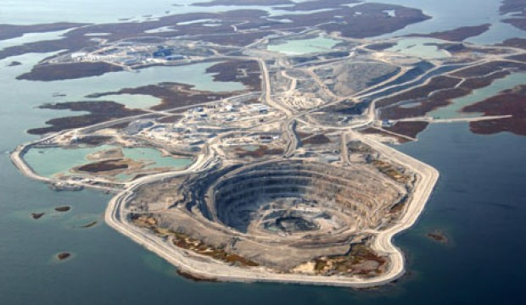
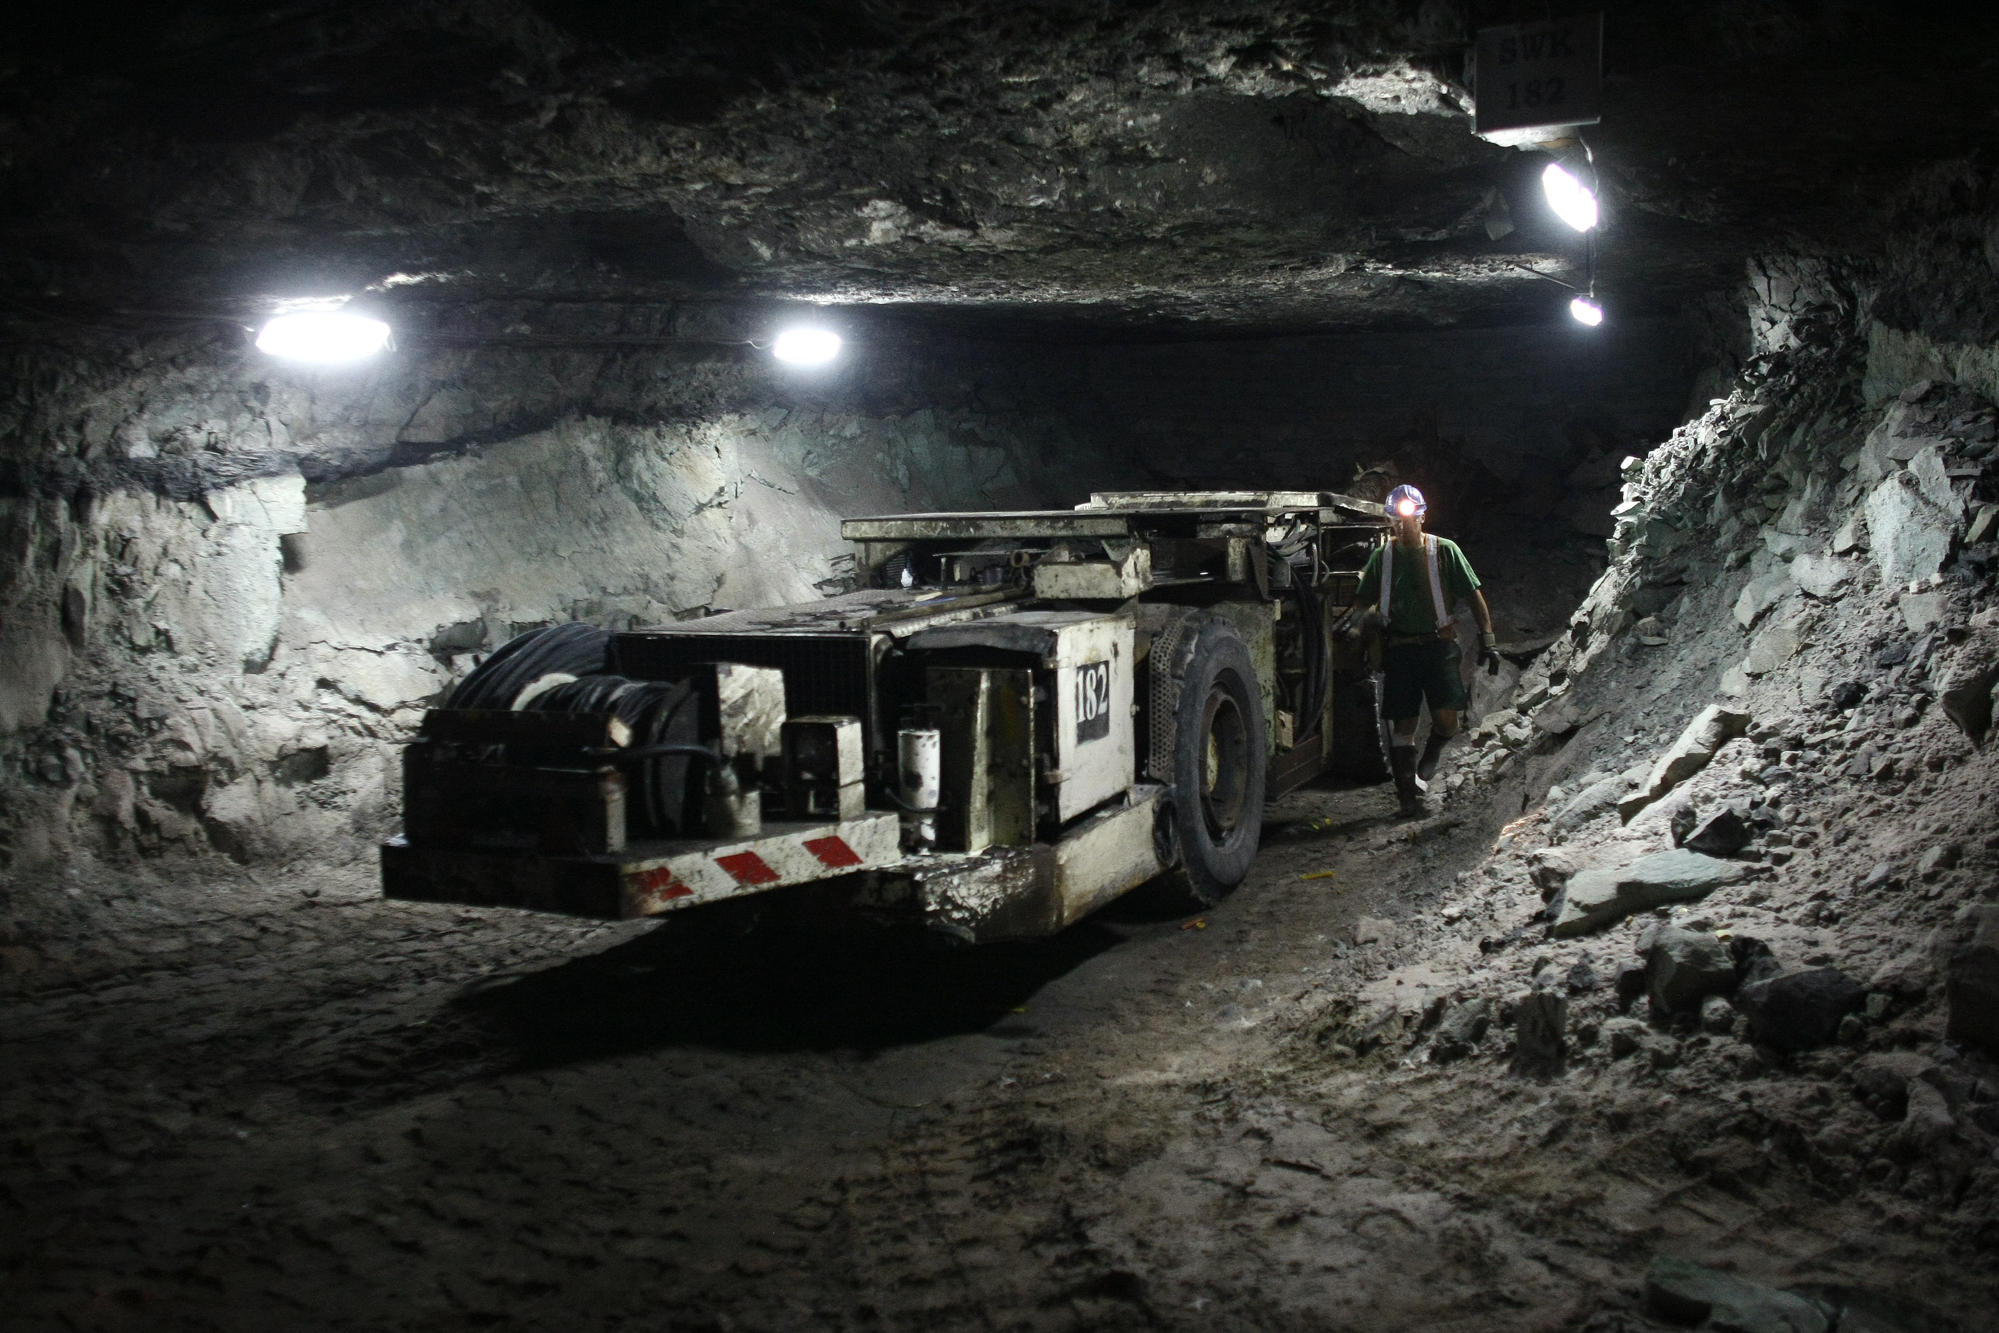
Addressable Market of over 1.8m Vehicles
Addressable Market of over 1.8m Vehicles
SUVs All Mines 90000 vehicles
Underground SUVs 30,000 vehicles
Oyu Tolgoi 700 SUVs, 10 Installed
Freeport 300 SUVs, 9 Installed
KGHM 400 SUVs pa, 50 Installed
22

Slide 23
Off Road Markets. International
All international distributors will to receive TD brakes in Q3
Trials with Isuzu UK and Isuzu Europe scheduled for February 2017
Isuzu Huntsman is an example of the market opportunity
Aeroklas Commercial Canopy with matching Roof Rails and Roof Vent
LINTRAN Transafe Drawer System with GapFlap
4 x 17" Black Alloy Wheels with Cooper Discoverer A/T3 Tyres
Pioneer F860BT VISION SatNav Pack with Reverse Camera Heavy duty black side steps
3.5T Towbar & 7PIN Electrics
Tailgate damper
De-Chrome Pack (inc. Black Roof Rails on Yukon models)
Under-rail bed liner 17" Spare Wheel Kit with Cooper Discoverer A/T3 Tyre Front & rear rubber trays

Slide 24
Retail Market Engagement: Off Road Market
Current Australian SIBS® Partners include retail & commercial fleet providers

Slide 25
Disclaimer
This presentation is prepared by Advanced Braking Technology Limited (ABN 66 099 107 623) (ABT, the Company or the Issuer) to provide summary information about ABT. ABT is an Australian public company listed on the Australian Securities Exchange (ASX). Statements in this presentation are made only as at the date of this presentation and the information in this presentation remains subject to change without notice. The information in this presentation is of a general nature and does not purport to be complete.
If an offer of securities in ABT is made, it will be made in a rights issue offer document issued under section 708AA of the Corporations Act 2001 (Cth) (Rights Issue Offer Document). Any decision to purchase or subscribe for securities in ABT must be made solely on information disclosed in the Rights Issue Offer Document to be issued in connection with such an offer. No representation or warranty, express or implied, is made as to the fairness, accuracy, completeness or correctness of the information, opinions, and conclusions contained in this presentation. This presentation does not purport to summarise all information that an investor should consider when making an investment decision.
No liability: Information in any Rights Issue Offer Document may differ materially in both content and presentation from the information in this presentation. The Issuer reserve the right to include different information in any Rights Issue Offer Document. To the maximum extent permitted by law, neither the Issuer nor Cashel Corporate Finance Pty Ltd ABN 131 324 608 (the Lead Manager) (an authorised representative of Cashel Financial Services Pty Ltd ABN 23 106 177 093 holding Australian Financial Service Licence number 306803) nor any of their respective affiliates or related bodies corporate or any of their respective officers, directors, employees and agents (Related Parties), nor any other person, accepts any responsibility or liability for the content of this presentation including, without limitation, any liability arising from fault or negligence, for any loss arising from the use of or reliance on any of the information contained in this presentation or in connection with it. The Issuer has prepared this presentation based on information available to them at the time of preparation. The Lead Manager, nor any of its Related Parties, accept any responsibility or liability for the contents of this presentation, and make no recommendation or warranty concerning this presentation, ABT or ABT’s securities (including any offer for such securities). The Lead Manager and its Related Parties have not been responsible for the preparation of, and have not authorised, permitted or caused the issue, dispatch or provision of this presentation and do not make or purport to make any statements in the presentation and these is no statement in this presentation which is based on any statement made by any of them. You represent, warrant and agree that you have not relied on any statements made by the Lead Manager or its Related Parties in relation to ABT securities and you also expressly disclaim that you are in a fiduciary relationship with any of them.
This presentation is not, and does not constitute, or form any part of, an offer to sell or the solicitation, invitation or recommendation to purchase any securities in the United States and neither this presentation nor anything contained herein shall form the basis of any contract or commitment. This presentation may not be distributed or released in the United States. Securities may not be offered or sold in the United States unless such securities are registered under the U.S. Securities Act 1933, as amended (U.S. Securities Act) or in a transaction exempt from, or not subject to, the registration requirements of the U.S Securities Act and any other applicable laws. Any public offering of securities in the United States would be made by means of a prospectus that would be obtained from the Issuer or selling security holder and that would contain detailed information regarding the company and management, as well as financial statements. Each institution or person that reviews this presentation will be deemed to represent that each such institution or person is not in the United States.
The distribution of this presentation outside Australia may be restricted by law. Persons who come into possession of this presentation who are not in Australia should seek advice and observe any such restrictions. Any failure to comply with such restrictions may constitute a violation of applicable securities laws.
Not financial product advice: To the extent that this presentation contains any advice, this is limited to general advice only. The advice has been prepared without taking into account your objectives, financial situation or needs and because of this you should therefore consider the appropriateness, in light of your own objectives, financial situation or needs, before following the advice. ABT recommends that you do not act on this advice without first consulting your investment adviser to determine whether the advice is appropriate for your investment objectives, financial situation and particular needs. If any advice in this presentation relates to the acquisition or possible acquisition of a particular financial product, you should obtain a copy of and consider the product disclosure statement, prospectus or other document for that financial product before making any decision.
You should make your own assessment of an investment in ABT based on the Rights Issue Offer Document and should not rely on this presentation. In all cases, you should conduct you own research of ABT and analysis of the financial condition, assets and liabilities, financial position and performance, profits and losses, prospects and business affairs of ABT and its businesses, and the contents of this presentation. You should seek legal, financial, tax and other advice appropriate for your jurisdiction.
Past performance: Past performance information given in this presentation is given for illustrative purposes only and should not be relied upon as (and is not) an indication of future performance.
Future performance: This presentation contains certain forward-looking statements with respect to financial condition, operations and business of ABT and certain plans and objectives of the management of ABT. Forward-looking statements can be identified by the use of forward-looking terminology, including, without limitation, the terms “believes”, “estimates”, “anticipates”, “expects”, “predicts”, “intends”, “plans”, “goals”, “:targets”, “aims”, “outlook”, “guidance”, “forecasts”, “may”, “will”, “would”, “could” or “should” or, in each case, their negative or other variations of comparable terminology. These forward-looking statements include all matters that are not historical facts.
Such forward-looking statements involve known and unknown risks, uncertainties and other factors which because of their nature may cause the actual results or performance of ABT to be materially different from the results or performance expressed or implied by such forward looking statements. Such forward looking statements are based on numerous assumptions regarding ABT’s present and future business strategies and the political and economic environment in which ABT will operate in the future, which may or may not be reasonable, and are not guarantees or predictions of future performance. No representation is made that any of these statements or forecasts will come to pass or that any forecast result will be achieved.
Forward-looking statements speak only as at the date of this presentation and to the full extent permitted by law, ABT, the Lead Manager and its affiliates and related bodies corporate and each of their respective directors, officers, employees, advisers, agents and intermediaries disclaim any obligation or undertaking to release any updates or revisions to information to reflect any change in any of the information contained in this presentation (including, but not limited to, any assumptions or expectations set out in this presentation).
Financial data: All figures in the presentation are A$ millions unless stated otherwise and all market shares are estimates only.
Financial information: The pro forma and forecast financial information provided in this presentation is for illustrative purposes only and does not represent a forecast or expectation by the Issuer as to ABT’s future financial condition and / or performance.

Slide 26
Contacts
Mr Graeme Sumner
Managing Director
Advanced Braking Technology Ltd
Phone: +61 (0) 447275998
graeme.sumner@advancedbraking.com
www.advancedbraking.com

Slide 27
Formal Business
Questions and Answers

